Slide 1
Real-Time AI-Powered Network Monitoring and Threat Prediction System
Data Mining
Team Members:
Naveen Kumar Kolla - 11801246 - Team Lead
Rahul Reddy Kesari - 11816160
Satya Santhosh Kumar Puram - 11820588
Aditya Narayana Reddy Nallimilli - 11805743

Slide 2
Abstract:
This project is aimed at creating a network traffic monitoring system based on AI in real-time.
Conventional systems are rule-based detection systems that cannot detect unknown and zero-day attacks.
Our system uses:
Machine Learning
Data Mining
Time-Series Analysis.
It identifies irregularities in real-time and anticipates threats or failures in the future.
The visualization and alerts are carried out in a live dashboard.

Slide 3
Project Objectives:
Real-time network traffic monitoring.
Elaborate important characteristics such as:
Packet size
Protocol type
Traffic rate
Identify: Red flags, Oddities.
Predict: Future attacks, Network failures.
Provide:Live dashboard with alerts

Slide 4
Problem Statement:
The networks today produce huge data per second.
Manual monitoring is:
Time-consuming and Inefficient
Existing systems:
Relied on pre-existing regulations.
It is unable to detect new or evolving attack.
Adaptive system with Real-time detection and Predictive capability

Slide 5
Tools & Technologies:
Programming & Libraries :Python ,Pandas, NumPy
Machine Learning: Scikit-learn, TensorFlow / PyTorch.
Network Analysis: Scapy
Visualization : Stream lit , Dashboard
Optional Tools: Weka, RapidMiner

Slide 6
Datasets :
1. CICIDS2017 Dataset:
Has realistic network traffic.
2.8 million network flows
80 features and Includes labeled attacks
2. NSL-KDD Dataset:
Better adaptation of KDD 1999.
125,000 instances
41 features
3. Real-Time Data
Sniffed with packet sniffing (Scapy)

Slide 7
Machine Learning Algorithms:
Applied to classify network traffic:
Decision Tree
Random Forest
Support Vector Machine (SVM).
K-Nearest Neighbors (KNN)
Naive Bayes
Multi-layer perceptron (Neural Networks)

Slide 8
Anomaly Detection Techniques &Time-Series Prediction:
Employed to detect unrecognised attacks.
Isolation Forest
One-Class SVM
Learn normal behaviour
Detect deviations (anomalies)
Applied to forecast the behaviour of the network in the future.
ARIMA Model
LSTM (Deep Learning)
Predicting traffic spikes
Detecting system overload
Preventing failures

Slide 9
System Architecture:
Data Collection = Datasets + Real-time traffic
Packet features = Feature Extraction.
Data Preprocessing = Cleaning & normalisation
ML & DL models = Model Training.
Prediction = Detect anomalies & threats
Visualization = Dashboard + Alerts

Slide 10
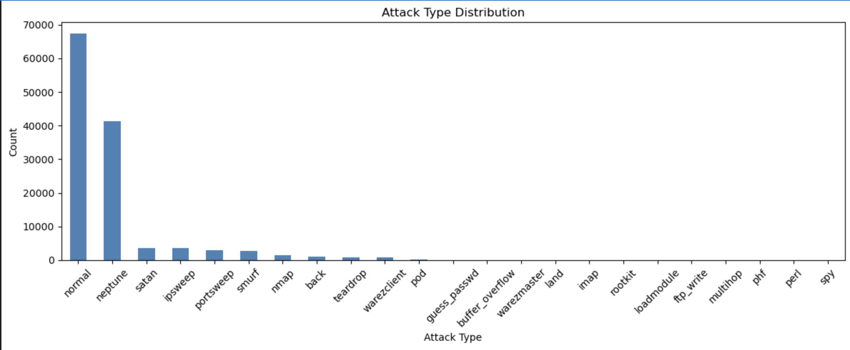
Outcomes:

Slide 11
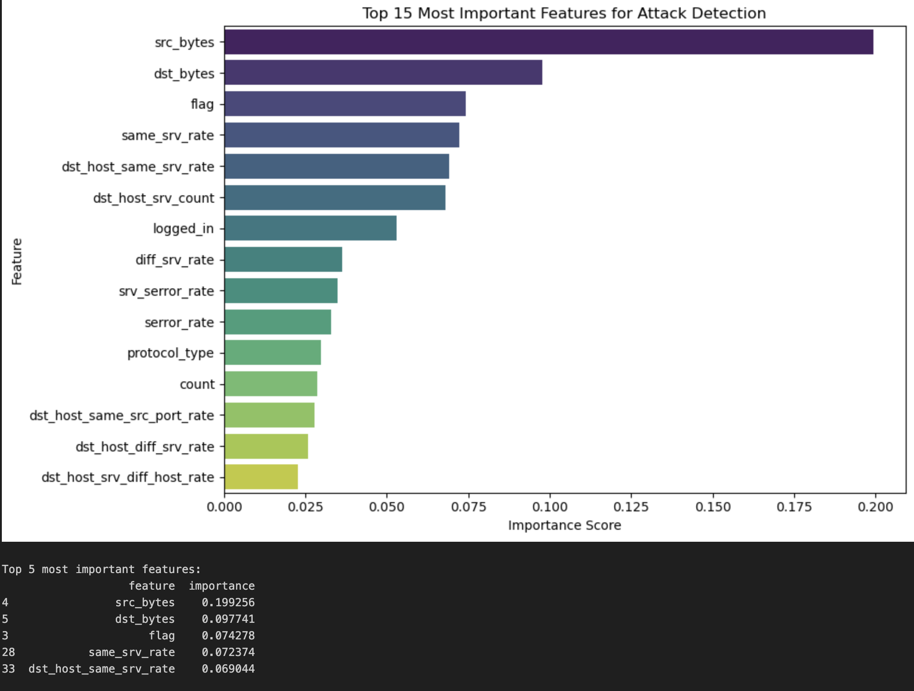
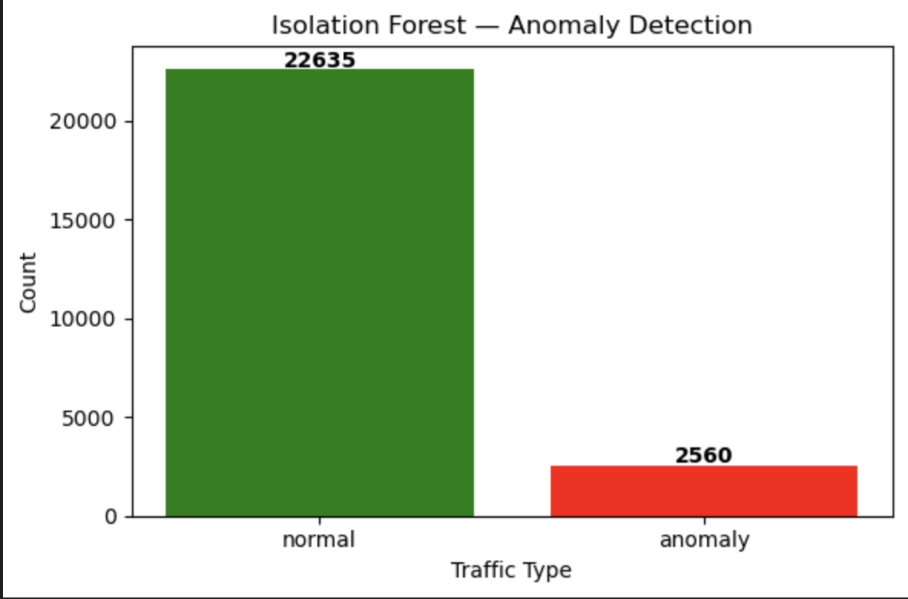
Outcomes:

Slide 12
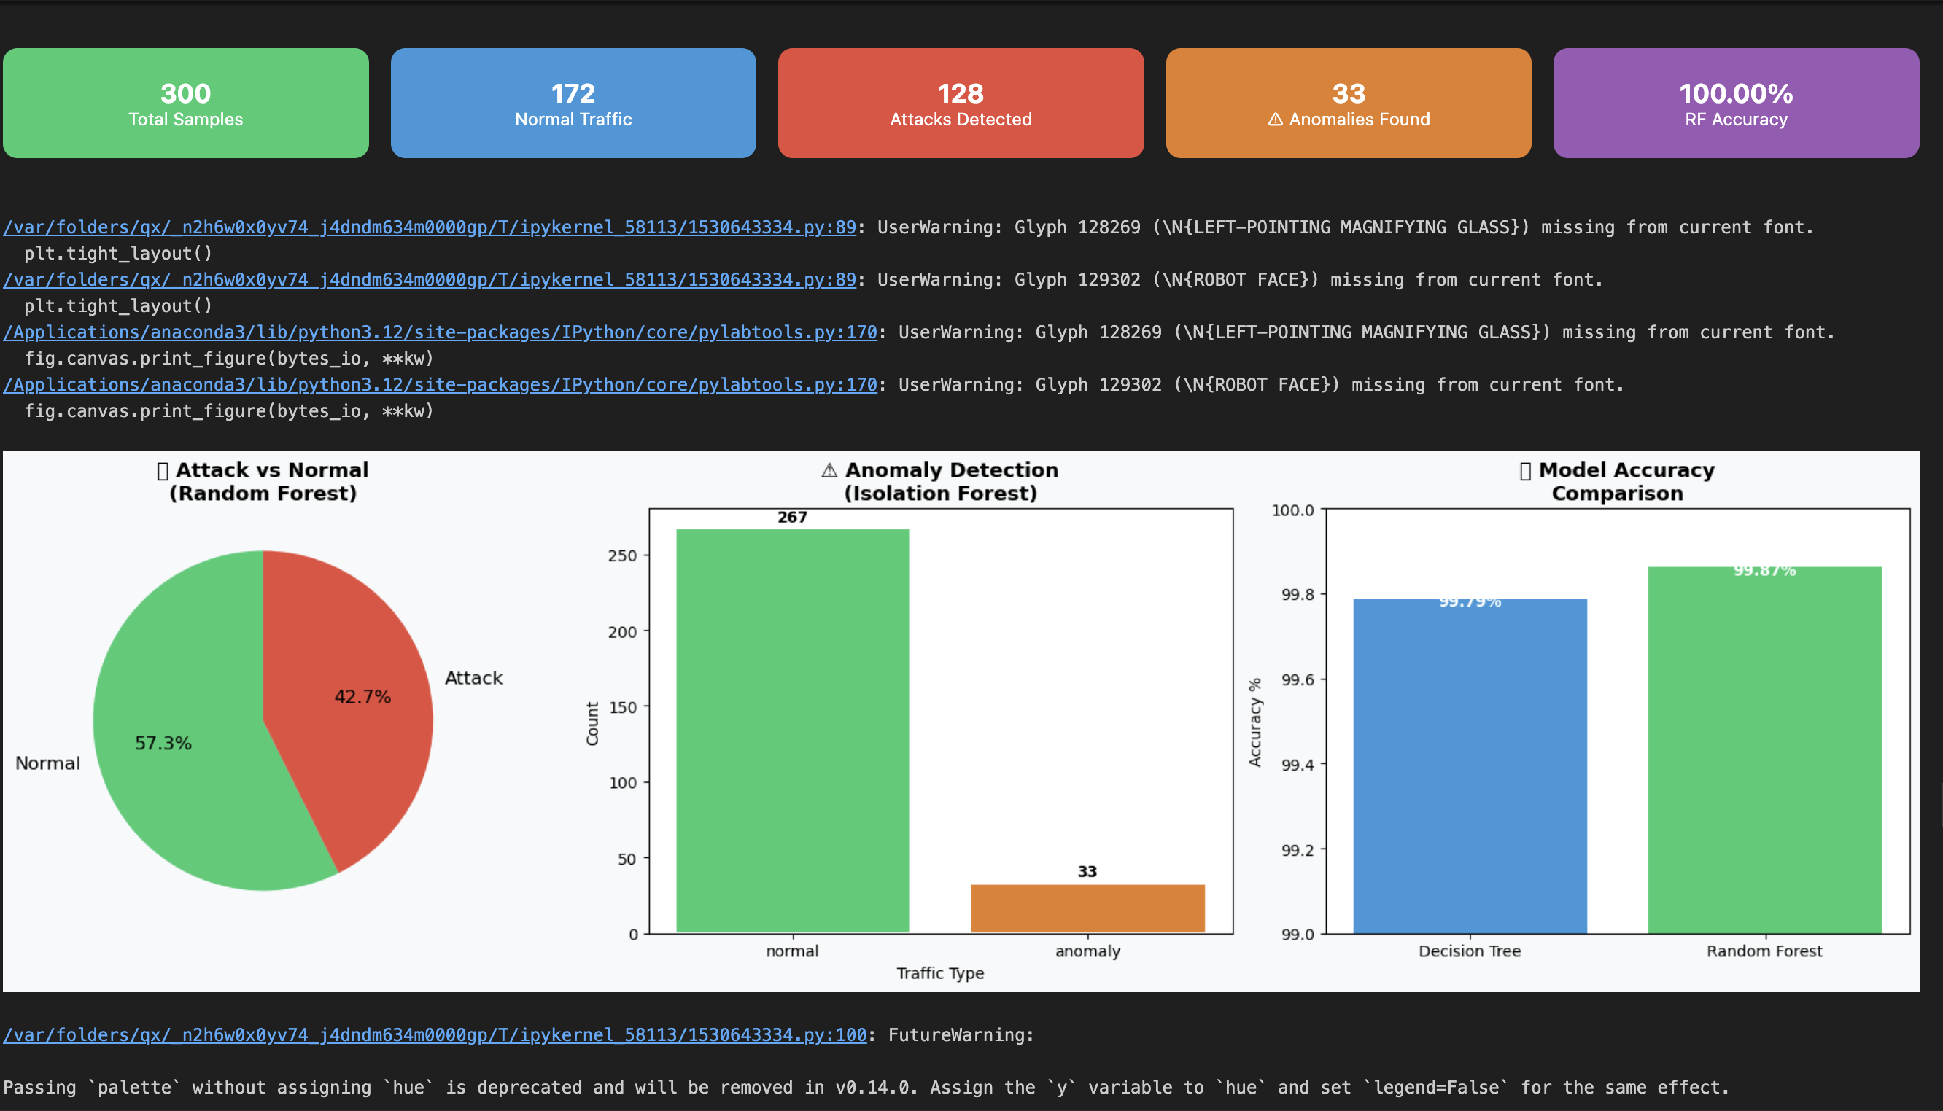
Outcomes:

Slide 13
Advantages:
Detects zero-day attacks.
Works in real-time.
Reduces manual effort.
Improves system reliability.
Scalable and adaptable.

Slide 14
Conclusion:
AI + Data Mining improves network security systems
System is:Intelligent with Adaptive nature along with Predictive analysis..
Helps organizations change: Reactive to Proactive security.

